Slide 1
1.4 Asocjacja - zaawansowane aspekty (rekurencyjna, n-arna)

Slide 2
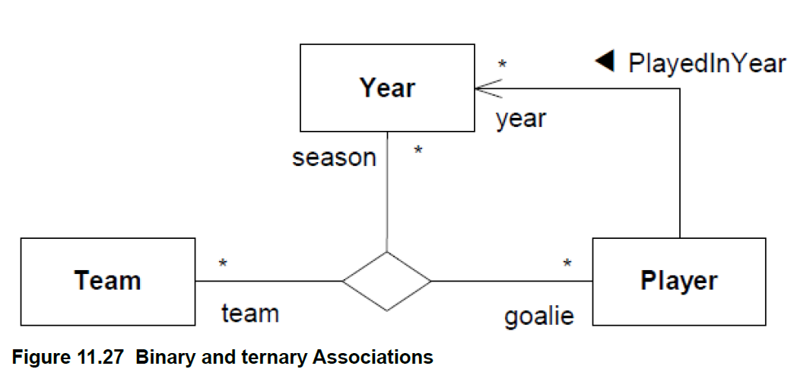
The solid triangle indicates the order of reading: Player PlayedInYear Year. The figure further shows a ternary
Association between Team, Year, and Player with ends named team, season, and goalie respectively.

Slide 3
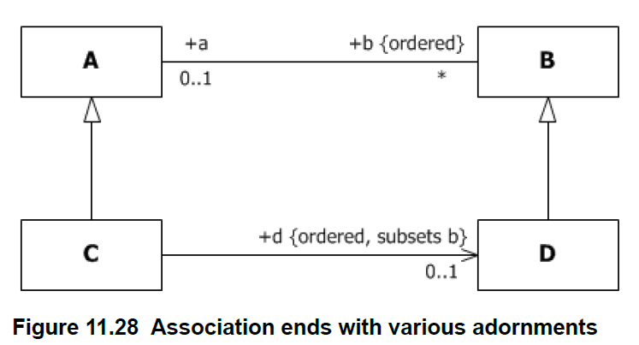
The following adornments are shown on the four Association ends in Figure 11.28.
Names a, b, and d on three of the ends.
Public visibility marked on the ends a, b and d.
Multiplicities 0..1 on a, * on b, and 0..1 on d.
Specification of ordering on b and d.
Subsetting on d. For an instance of Class C, the collection d is a subset of the collection b. This is equivalent to
the OCL constraint:
context C inv: b->includesAll(d)

Slide 4
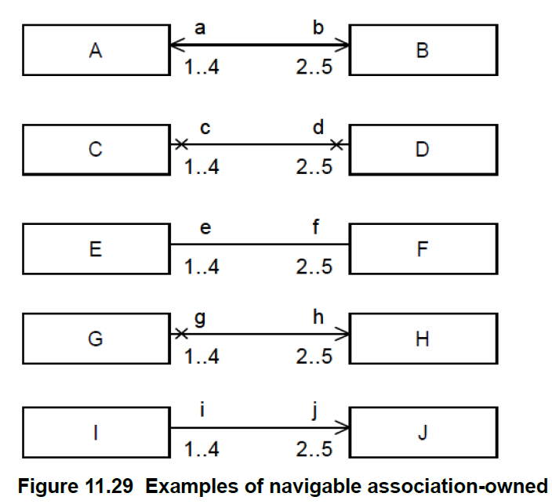
In Figure 11.29:
The top pair AB shows a binary Association with two navigable ends.
The second pair CD shows a binary Association with two non-navigable ends.
The third pair EF shows a binary Association with unspecified navigability. In a diagram where arrows are only shown for one-way navigable associations, this probably signifies bidirectional navigability.
The fourth pair GH shows a binary Association with one end navigable and the other non-navigable.
The fifth pair IJ shows a binary Association with one end navigable and the other non-navigable, in a diagram where arrows are only shown for one-way navigable associations, and crosses are suppressed.

Slide 5
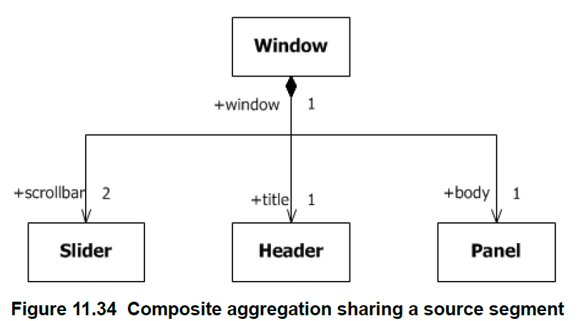
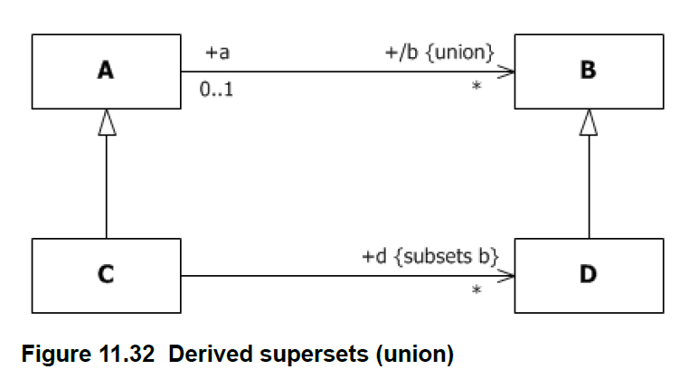
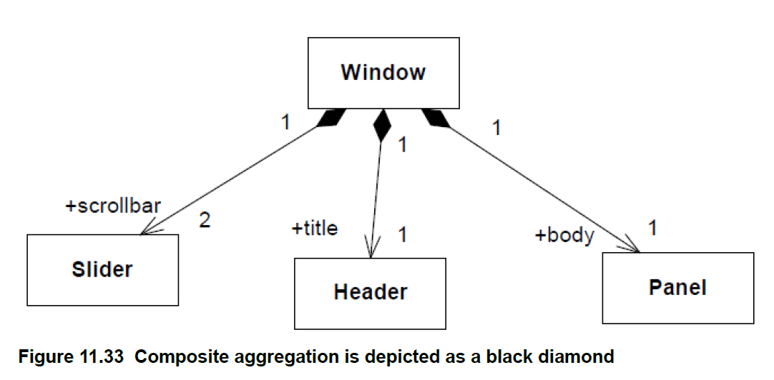

Slide 6
